Slide 1
Time Series Analysis
Basics of Time Series Analysis
Nicoleta Serban, Ph.D.
Associate Professor
Stewart School of Industrial and Systems Engineering
Basic Statistical Concepts

Slide 2
About this lesson

Slide 3
Review of Basic Statistical Concepts
Moments of a Distribution: Fully characterizing the distribution
Estimation Methods: Method of Moments versus Maximum Likelihood Estimation
Basic Estimators: Approach and Sampling Distribution
Multivariate data: Joint, marginal, and conditional distribution
Statistical Inference: Confidence intervals and Hypothesis Testing

Slide 4
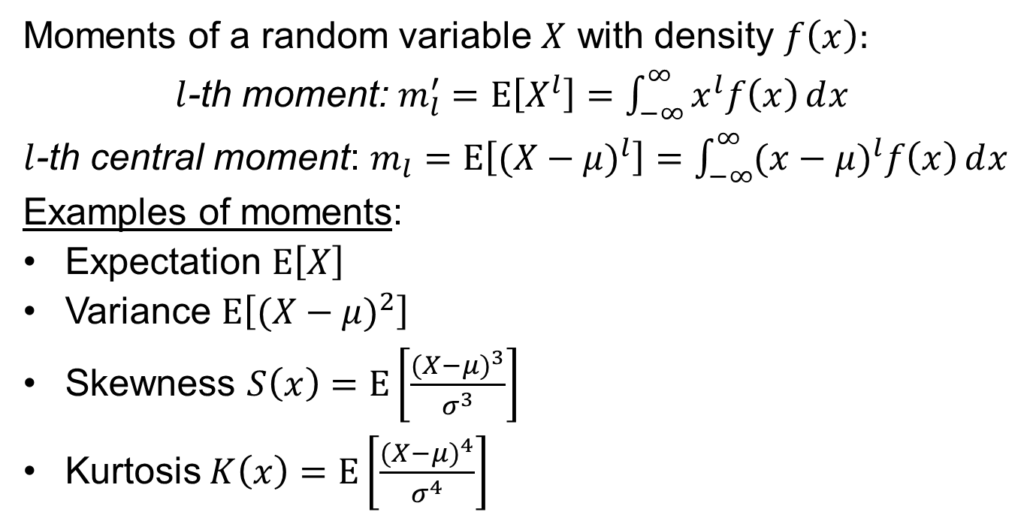
Moments of a Distribution
Moments of a random variable $X$ with density $f\left(x\right):$
$l$-th moment: $m_{l}^{′}=Ε\left[X^{l}\right]=\int_{−∞}^{∞}{x^{l}f\left(x\right)ⅆx}$
$l$-th central moment: $m_{l}=Ε\left[({X−μ)}^{l}\right]=\int_{−∞}^{∞}{{(x−μ)}^{l}f\left(x\right)ⅆx}$
Examples of moments:
Expectation $Ε\left[X\right]$
Variance $Ε\left[({X−μ)}^{2}\right]$
Skewness $S\left(x\right)=Ε\left[\frac{{(X−μ)}^{3}}{σ^{3}}\right]$
Kurtosis $K\left(x\right)=Ε\left[\frac{{(X−μ)}^{4}}{σ^{4}}\right]$
Notes:
Skewness (symmetry) ; Kurtosis fat tails

Slide 5
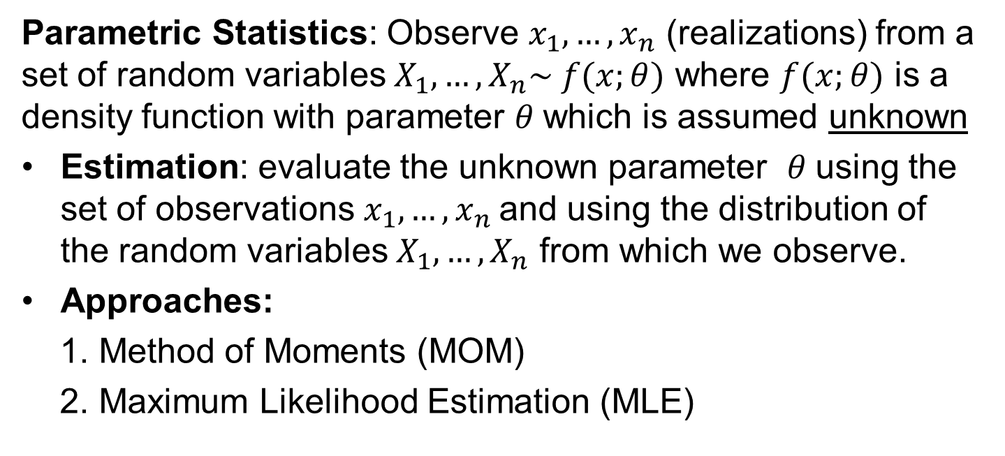
Statistical Estimation
Parametric Statistics: Observe $x_{1},…, x_{n}$ (realizations) from a set of random variables $X_{1},…, X_{n}\sim f(x;θ)$ where $f(x;θ)$ is a density function with parameter $θ$which is assumed unknown
Estimation: evaluate the unknown parameter $θ$using the set of observations $x_{1},…, x_{n}$and using the distribution of the random variables $X_{1},…, X_{n}$ from which we observe.
Approaches:
1. Method of Moments (MOM)
2. Maximum Likelihood Estimation (MLE)

Slide 6
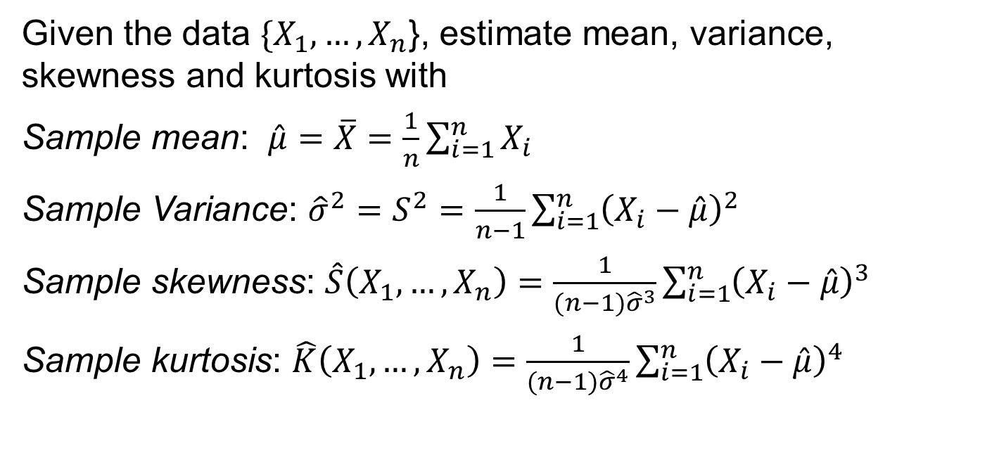
Examples of Classic Estimators
Given the data ${\{X}_{1},…, X_{n}$}, estimate mean, variance, skewness and kurtosis with
Sample mean: $\hat{μ}=\overline{X}=\frac{1}{n}\sum_{i=1}^{n}{X_{i}}$
Sample Variance: ${\hat{σ}}^{2}=S^{2}=\frac{1}{n−1}\sum_{i=1}^{n}{{\left(X_{i}−\hat{μ}\right)}^{2}}$
Sample skewness: $\hat{S}\left(X_{1},…, X_{n}\right)=\frac{1}{(n−1){\hat{σ}}^{3}}\sum_{i=1}^{n}{{\left(X_{i}−\hat{μ}\right)}^{3}}$
Sample kurtosis: $\hat{K}\left(X_{1},…, X_{n}\right)=\frac{1}{(n−1){\hat{σ}}^{4}}\sum_{i=1}^{n}{{\left(X_{i}−\hat{μ}\right)}^{4}}$

Slide 7
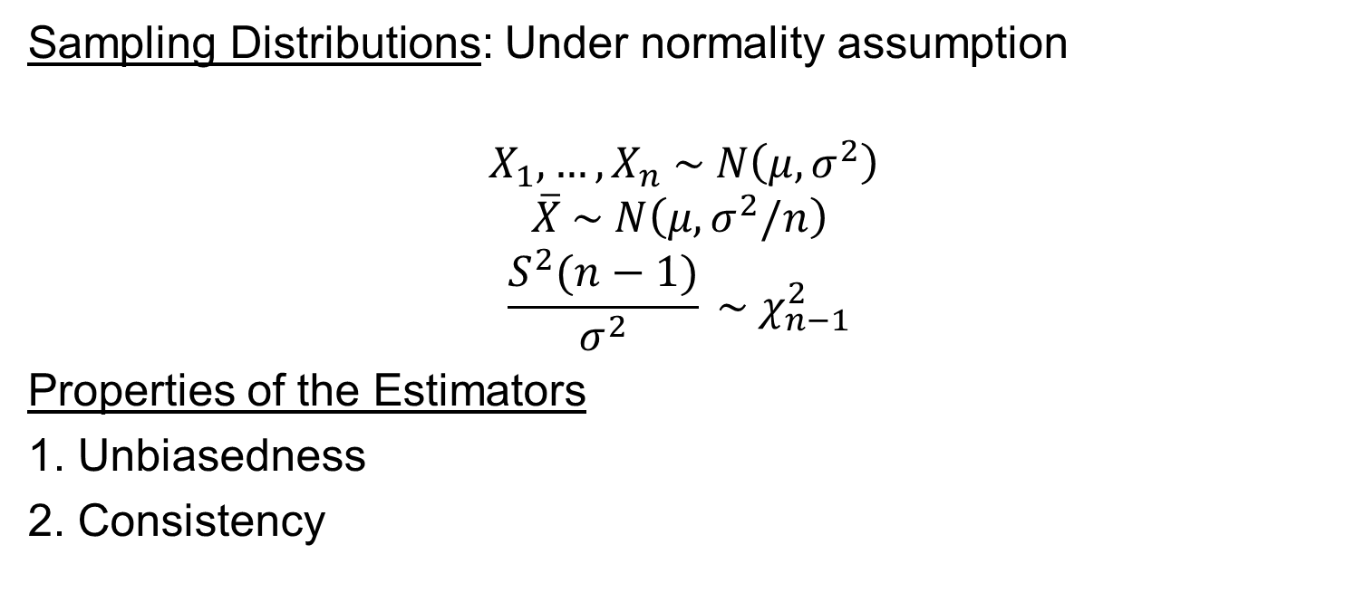
Sampling Distributions of Estimators
Sampling Distributions: Under normality assumption
$${ X}_{1},…, X_{n} \sim N\left(μ,σ^{2}\right)$$
$$\overline{X} \sim N\left(μ,σ^{2}/n\right)$$
$$\frac{S^{2}(n−1)}{σ^{2}} \sim χ_{n−1}^{2}$$
Properties of the Estimators
1. Unbiasedness
2. Consistency

Slide 8
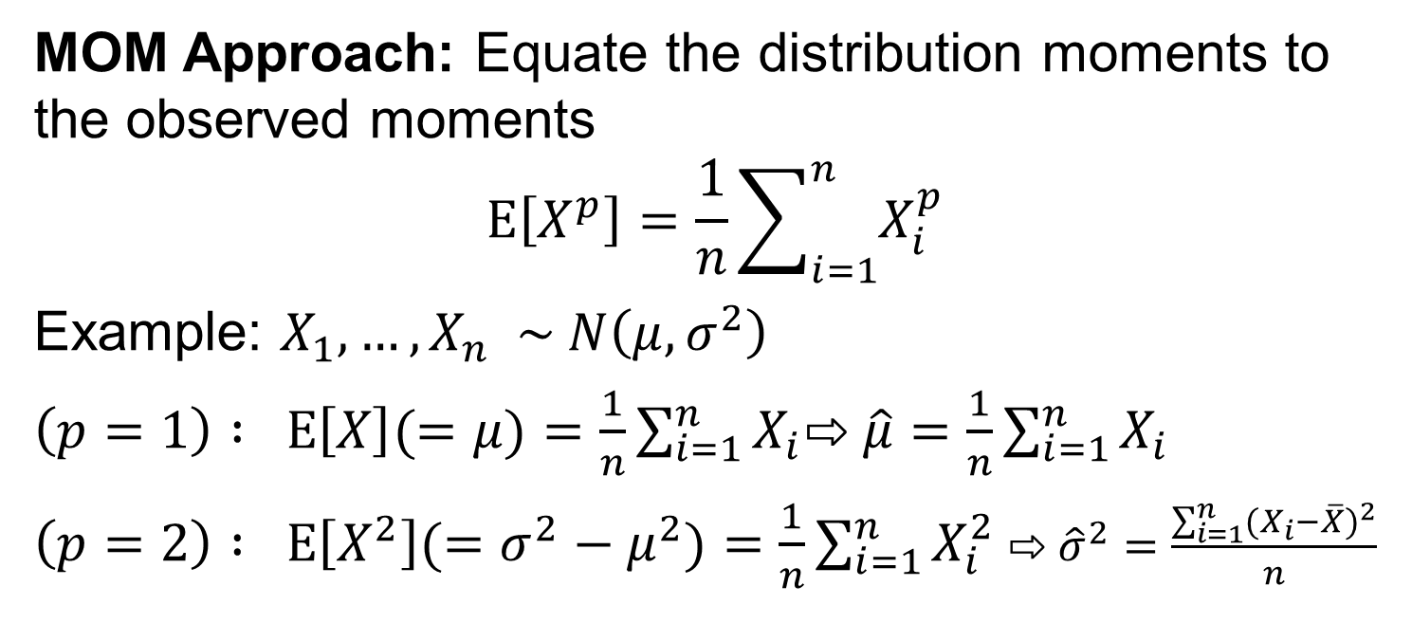
Method of Moments Estimation
MOM Approach: Equate the distribution moments to the observed moments
$$Ε\left[X^{p}\right]=\frac{1}{n}\sum_{i=1}^{n}{X_{i}^{p}}$$
Example: $X_{1},…, X_{n} \sim N\left(μ, σ^{2}\right)$
$\left(p=1\right) : Ε\left[X\right](=μ)=\frac{1}{n}\sum_{i=1}^{n}{X_{i}}$⇨ $\hat{μ}=\frac{1}{n}\sum_{i=1}^{n}{X_{i}}$
$\left(p=2\right) : Ε\left[X^{2}\right](=σ^{2}−μ^{2})=\frac{1}{n}\sum_{i=1}^{n}{X_{i}^{2}}$ ⇨ ${\hat{σ}}^{2}=\frac{\sum_{i=1}^{n}{{(X}_{i}−{\overline{X})}^{2}}}{n}$

Slide 9
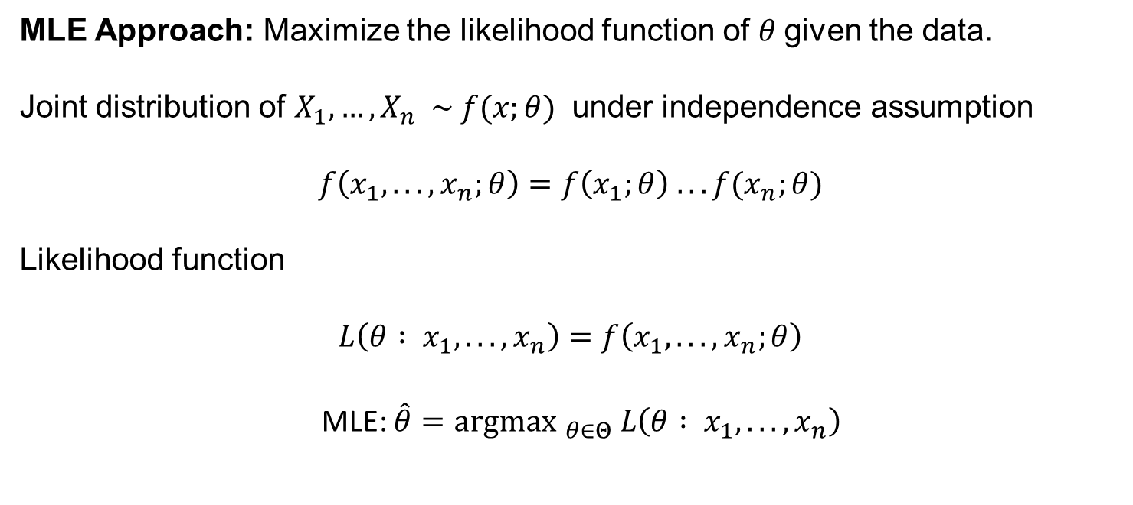
Maximum Likelihood Estimation
MLE Approach: Maximize the likelihood function of $θ$given the data.
Joint distribution of $X_{1},…, X_{n} \sim f(x;θ)$ under independence assumption
$$f\left(x_{1}, .. ., x_{n};θ\right)=f\left(x_{1};θ\right) .. .f(x_{n};θ)$$
Likelihood function
$$L\left(θ : x_{1}, .. ., x_{n}\right)=f\left(x_{1}, .. ., x_{n};θ\right)$$
MLE: $\hat{θ}={\text{argmax} }_{θ∈Θ} L\left(θ : x_{1}, .. ., x_{n}\right)$

Slide 10
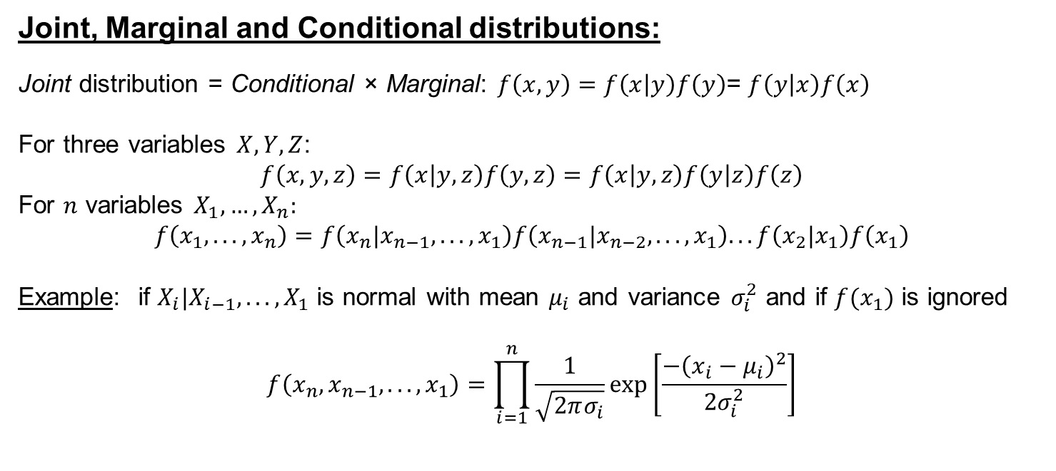
Multivariate Distribution
Joint, Marginal and Conditional distributions:
Joint distribution = Conditional × Marginal: $f\left(x,y\right)=f\left(x | y\right)f\left(y\right)$= $f\left(y | x\right)f\left(x\right)$
For three variables $X, Y, Z$:
$$f\left(x,y,z\right)=f\left(x | y,z\right)f\left(y,z\right)=f\left(x | y,z\right)f\left(y | z\right)f\left(z\right)$$
For $n$ variables $X_{1},…, X_{n}:$
$$f\left(x_{1}, .. ., x_{n}\right)=f\left({x_{n}|x}_{n−1}, .. ., x_{1}\right)f\left({x_{n−1}|x}_{n−2}, .. ., x_{1}\right).. .f\left({x_{2}|x}_{1}\right)f\left(x_{1}\right)$$
Example: if $X_{i}|X_{i−1}, .. ., X_{1}$ is normal with mean $μ_{i}$ and variance $σ_{i}^{2}$ and if $f(x_{1})$ is ignored
$$f\left(x_{n},x_{n−1}, .. . , x_{1}\right)=\prod_{i=1}^{n}{\frac{1}{\sqrt{2πσ_{i}}}\text{exp}\left[\frac{−{\left(x_{i}−μ_{i}\right)}^{2}}{2σ_{i}^{2}}\right]}$$

Slide 11
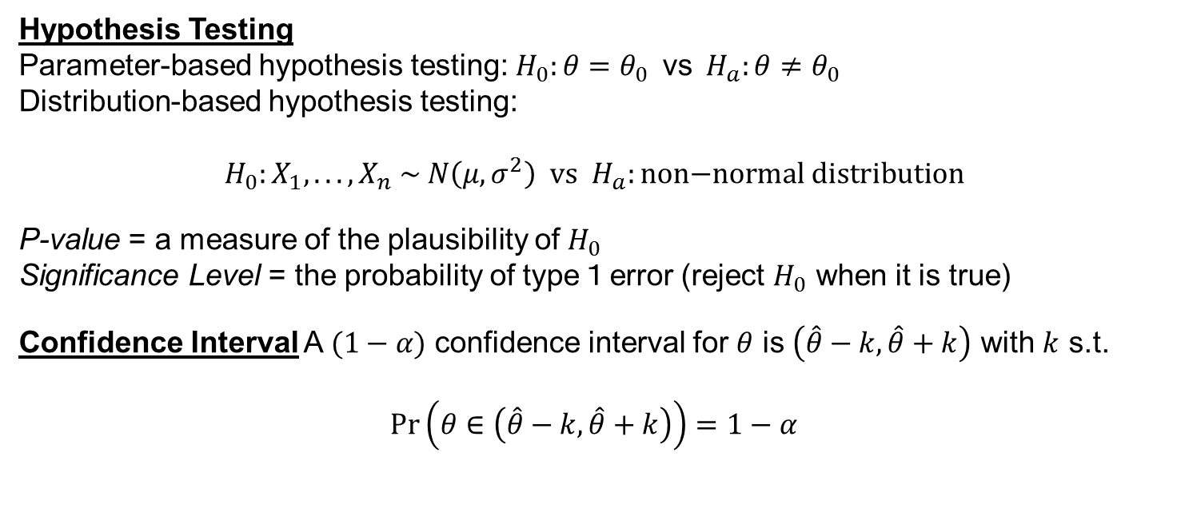
Statistical Inference
Hypothesis Testing
Parameter-based hypothesis testing: $H_{0}:θ=θ_{0} \text{vs} H_{a}:θ≠θ_{0}$
Distribution-based hypothesis testing:
$$H_{0}:X_{1}, .. . , X_{n} \sim N\left(μ,σ^{2}\right) \text{vs} H_{a}:\text{non}\text{−}\text{normal} \text{distribution}$$
P-value = a measure of the plausibility of $H_{0}$
Significance Level = the probability of type１error (reject $H_{0}$ when it is true)
Confidence Interval A $(1−α)$ confidence interval for $θ$ is $\left(\hat{θ}−k, \hat{θ}+k\right)$ with $k$ s.t.
$$\operatorname{Pr}\left(θ∈\left(\hat{θ}−k, \hat{θ}+k\right)\right)=1−α$$
Notes:
P-value: The smaller the p-value is, the less plausible $H_{0}$

Slide 12
Summary

